Slide 1
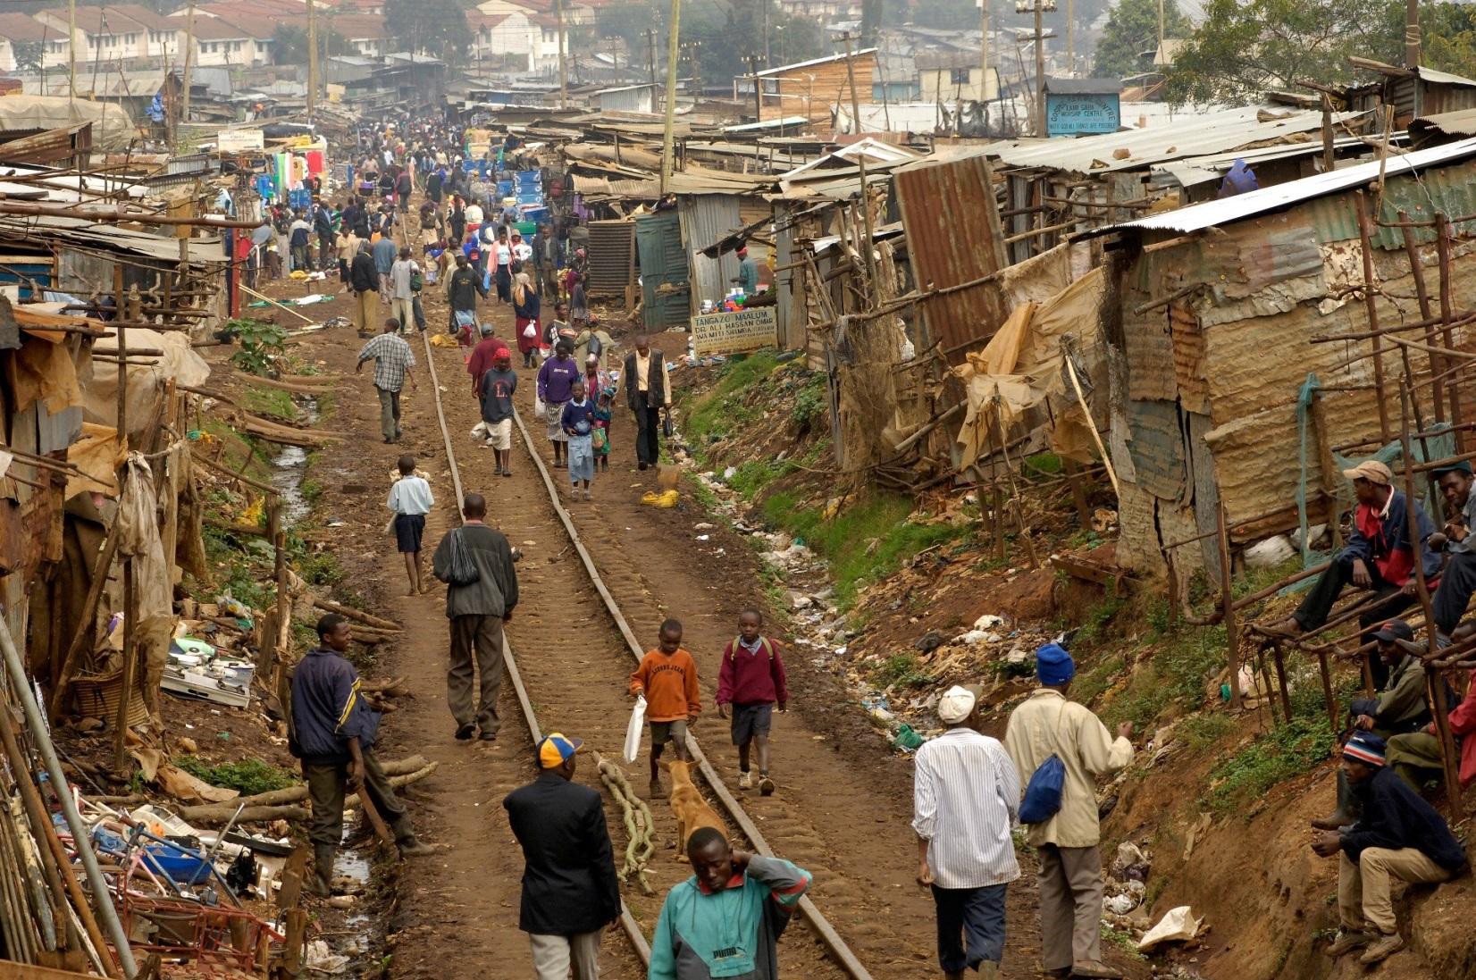
Human Wellbeing

Slide 2
Learning Intentions and Success Criteria 8/3/24
LI
SC
Examine what is meant by ‘wellbeing’, including the three variables – wealth, health and education. Examine how human wellbeing can be measured.
Define ‘human wellbeing’ and development. Differentiate between an LEDC and MEDC. Apply SPICESS to the context of ‘human wellbeing’.

Slide 3
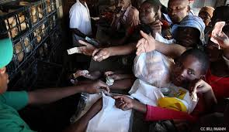
What is human wellbeing?
Refers to people’s quality of life
Takes into account the extent to which an individual, group or country can be characterised as being healthy, happy and prosperous.

Slide 4
Definition – Human wellbeing
Combination of physical, emotional, social, economic, environmental and political factors that vary between people and places.

Slide 5
Definition - development
A process of change that improves the quality of life of a community.

Slide 6
MEDC v LEDC
Formerly a Developed Country – a rich, industrialised country of the world. Sometimes referred to as ‘MEDC’s or More Economically Developed Countries.
EXAMPLES: USA, Japan, Australia and South Korea
Formerly a Developing Country – a poor or middle – income country often dependent on subsistence farming. Sometimes referred to as ‘LEDC’s or Less Economically Developed Countries.
EXAMPLES: Including countries located in the continent of Africa, such as Kenya, Mozambique and Ethiopia.

Slide 7
Key features of MEDC’s
Low birth rates
Low rates of poverty
High education levels
High GDP per capita
High HDI score

Slide 8
Key features of LEDC’s – Pick 8
Low per capita income
Dietary deficiencies
High infant mortality rates
Child exploitation
Lack of access to clean water and sanitation
Illiteracy
High rates of population growth
Lack of adequate shelter
Higher birth rates
Low-medium HDI score
Lower education levels
High rates of poverty
Low but increasing GDP per capita.

Slide 9
MEASURING & MAPPING – HUMAN WELLBEING
Human wellbeing can be measured using qualitative (subjective) measures of how people perceive the quality of life they experience, or quantitative (objective) measures, for example income, education levels and life expectancy.

Slide 10
Qualitative indicators
Qualitative or subjective indicators
Indicators of human wellbeing are those aspects of standard of living that are difficult to measure
Examples include – political freedoms, personal security and safety and social opportunities.
Qualitative → Quality

Slide 11
Quantitative indicators
Quantitative indicators are objective and measurable.
Typically take the form of numbers, data or an index score
Examples include – Gross National Product (GNP), Gross Domestic Product (GDP)
Quantitative → Quantity

Slide 12
Spatial patterns and indicators 
Spatial patterns emerge when qualitative and quantitative indicators of human wellbeing are m______________.
Spatial patterns, reasons for patterns and ways in which patterns change over time can be studied by a geographer.

Slide 13
Spatial patterns and indicators
Spatial patterns emerge when qualitative and quantitative indicators of human wellbeing are mapped.
Spatial patterns, reasons for patterns and ways in which patterns change over time can be studied by a geographer.

Slide 14
Economic & social development– types of indicators
Economic indicators:
An economic indicator of development is a measure of a country’s economy and wealth.
Example: Gross National Product (GNP)

Slide 15
Economic & social development– types of indicators
Human or Social Indicators:
A human or social indicator of development is a measure of development based on health, welfare and education of the people in a country.
Example: Infant mortality, literacy rate

Slide 16
Three of the most important variables that influence the level of wellbeing
Wealth
Health
Education

